Slide 1
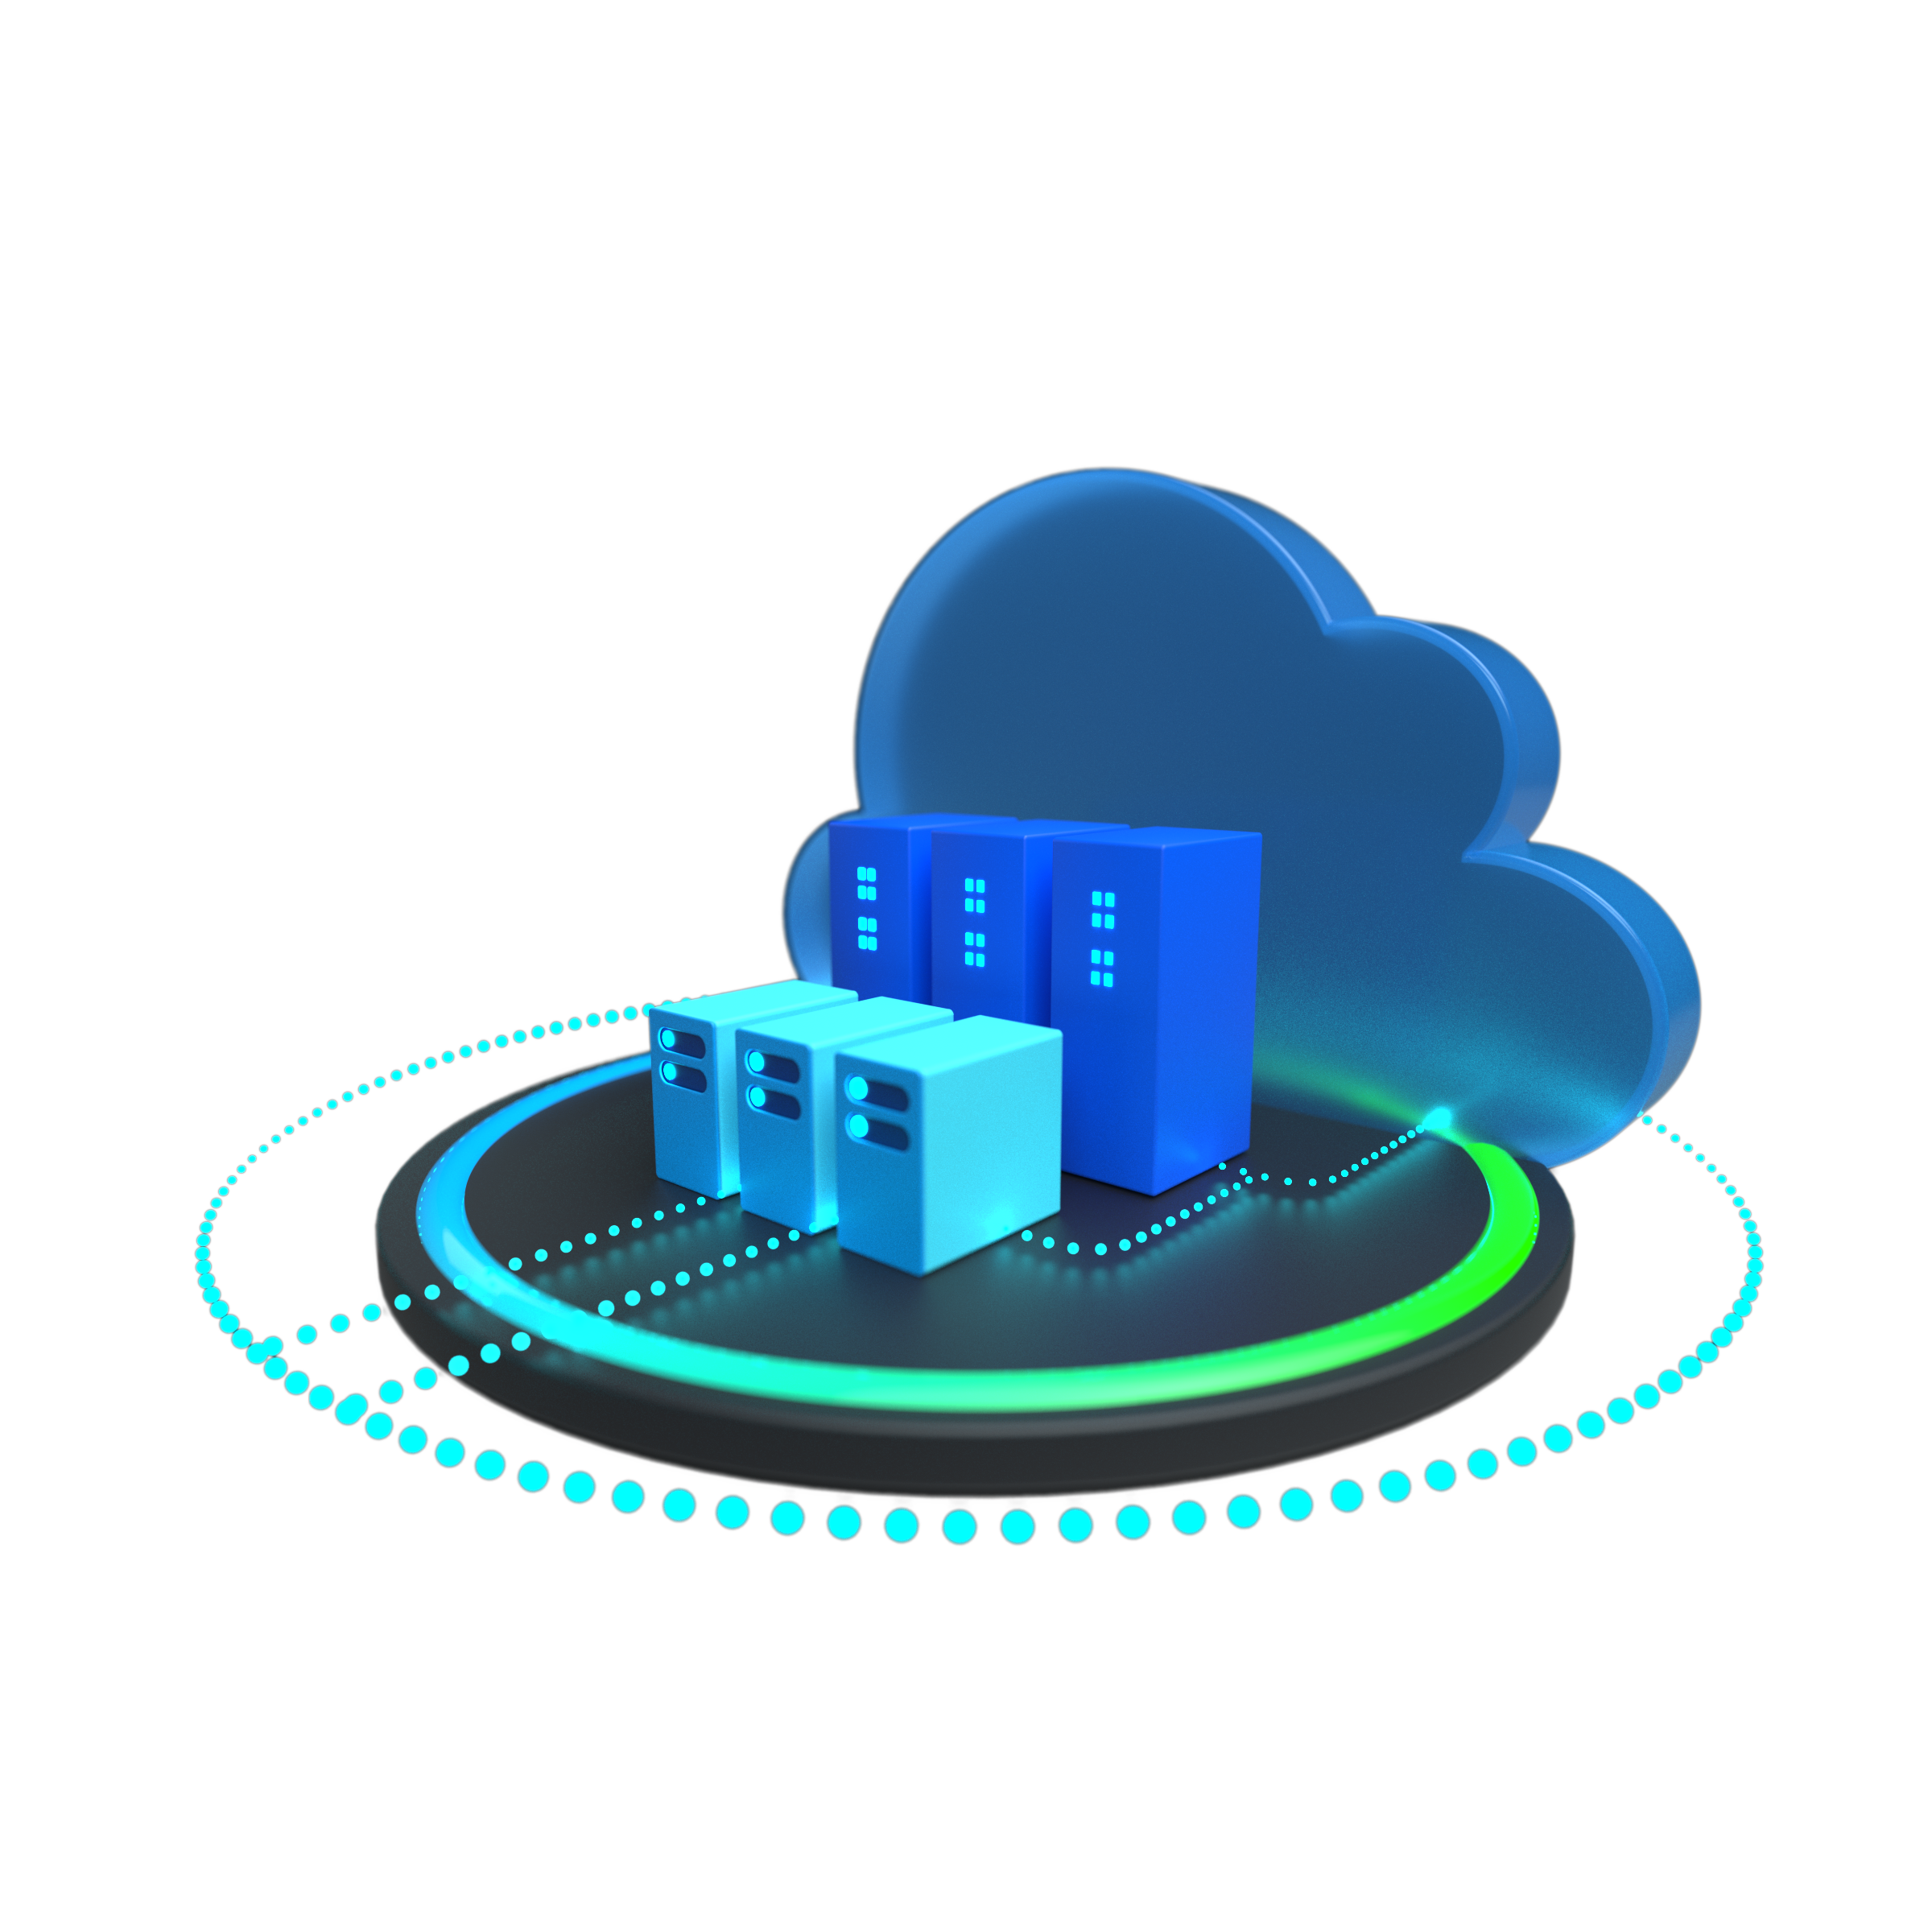
Azure VMware Solution Trial SKU Pilot

Slide 2
AVS Trial SKU Pilot – What It Does
The Azure VMware Solution (AVS) Trial SKU pilot, supported by the trial SKUs, does five main things;
Deploys the AVS private cloud.
Connects the AVS private cloud to Azure vNet.
Connects the AVS private cloud to the customer’s on-prem environment via their on-premises ExpressRoute.
Deploys VMware HCX Connector to the on-premises VMware cluster and connects that to the VMware HCX Cloud Manager within the AVS private cloud.
Provides prescriptive testing scenarios to validate the most common migration use cases.
NOTE: Steps 1-4 is completed via automation.

Slide 3
AVS Trial SKU Pilot – What It Does NOT Do
The Azure VMware Solution (AVS) Trial SKU pilot supports what is outlined in the prescriptive testing scenarios, any other activities would be considered out of scope for the trial pilot SKU.
Any scenarios the customer requires outside of those outlined in this Trial SKU pilot can be architected in parallel to or after the pilot. Implementation of those configurations must be done after the 30-day pilot has ended OR the prescriptive testing scenarios have been satisfied in the eyes of the customer.
Resources to support the use cases not included in the prescriptive testing scenarios would include the AVS GBB via a OneAsk and/or AVS migration partners.
More details for Azure VMware Solution, including field enablement, customer content, investments and programs, and partner information can be found on GearUp.

Slide 4
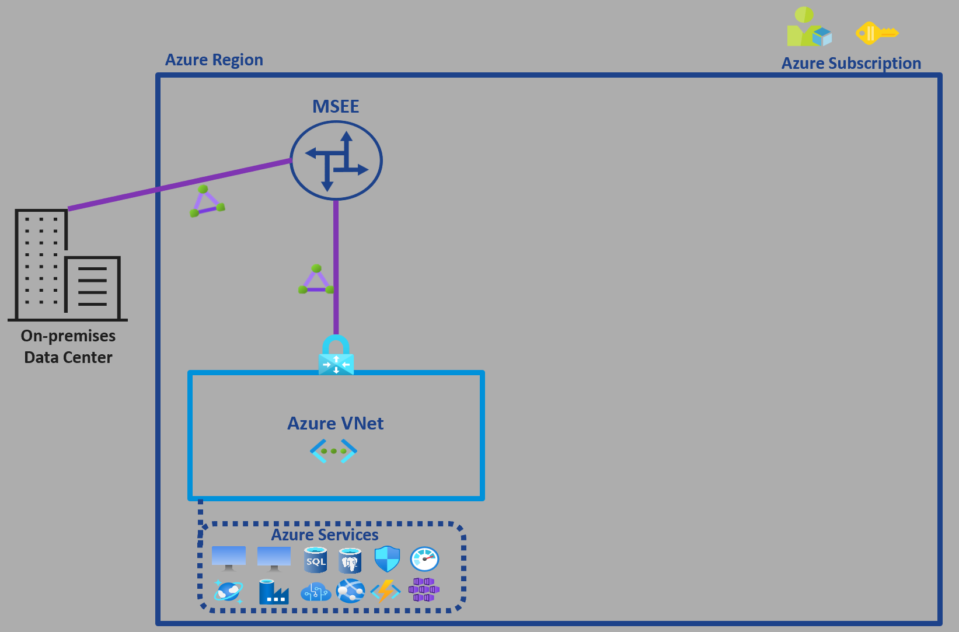
Prerequisites
The graphic depicts the minimum requirement for the AVS Private Cloud deployment.
If VPN connects the customer’s on-premises environment to Azure, then skip to the VPN section of this presentation.
Next

Slide 5
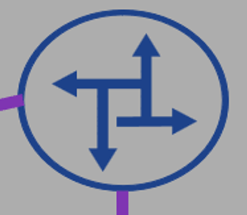




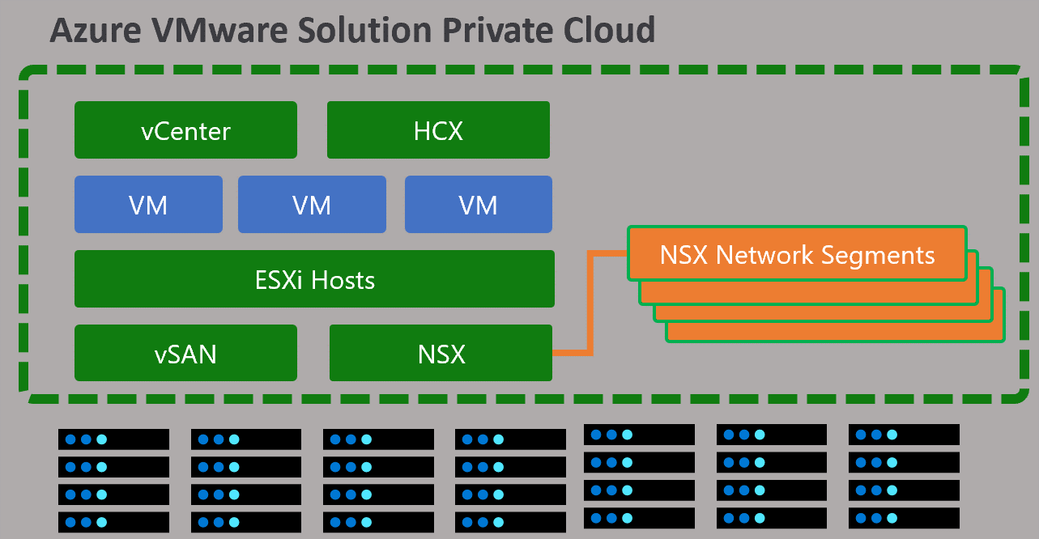
Private Cloud Deployment
The first part of the automation tool will do the following;
Deploy the AVS Private Cloud
Connect AVS ExpressRoute to the existing vNet Gateway.
Build GlobalReach connection to facilitate communication between AVS and On-Prem
D-MSEE
ExpressRoute Global Reach
Next

Slide 6
AVS Private Cloud Deployment – Let’s Get Started
Make sure that the AVS Trial SKU has been submitted for AND approved.
Veri

Slide 7














Azure Region
Azure Subscription
MSEE
D-MSEE
ExpressRoute GlobalReach
On-premises
Data Center
Azure VNet
Azure VMware Solution Private Cloud
vCenter
HCX
VM
VM
VM
ESXi Hosts
NSX Network Segments
Azure Services
vSAN
NSX

Slide 8


Azure Region
Azure Subscription
MSEE
D-MSEE
ExpressRoute GlobalReach
On-Prem <-> AVS
ExpressRoute
Azure vNets <-> AVS
ExpressRoute
Azure vNets <-> On-Prem
On-premises
Data Center
Azure VNet
AVS NSX-T Network Segments
Azure Services

Slide 9
Azure Region
Azure Subscription
MSEE
D-MSEE
ExpressRoute GlobalReach
On-Prem <-> AVS
ExpressRoute
Azure vNets <-> AVS
ExpressRoute
Azure vNets <-> On-Prem
On-premises
Data Center
Azure VNet
AVS NSX-T Network Segments
Azure Services

Slide 10
Azure Region
Azure Subscription
MSEE
D-MSEE
ExpressRoute GlobalReach
On-Prem <-> AVS
ExpressRoute
Azure vNets <-> AVS
ExpressRoute
Azure vNets <-> On-Prem
On-premises
Data Center
Azure VNet
AVS NSX-T Network Segments
Azure Services

